Slide 1
MCB3421 2019
Class 1 & 2

Slide 2
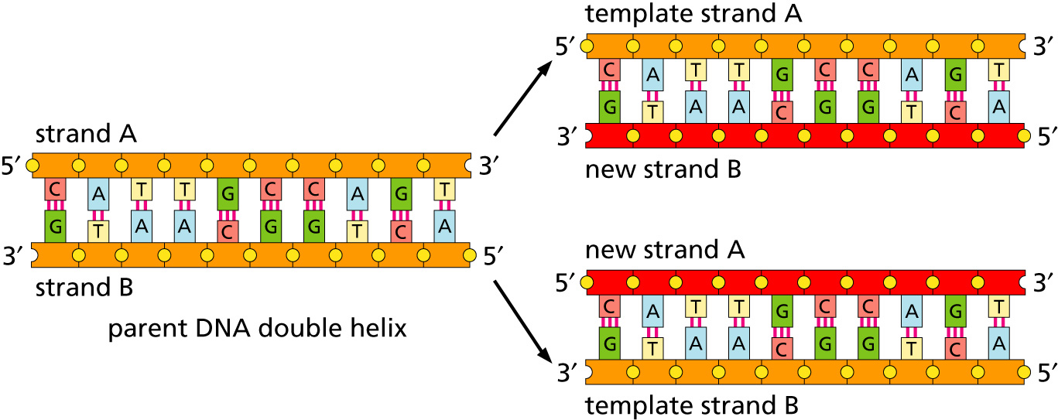
Replication
lagging and leading strand - strand bias
see Drew Barry’s animation at https://www.youtube.com/watch?v=7Hk9jct2ozY at 2.30 minutes

Slide 3
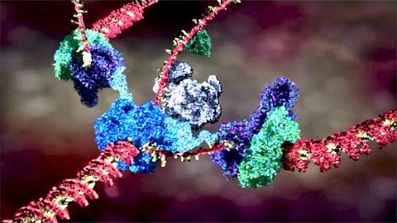
Replication
https://www.youtube.com/embed/X_tYrnv_o6A?start=60
Start at 1 minute stop at 2 minutes
Drew Berry

Slide 4
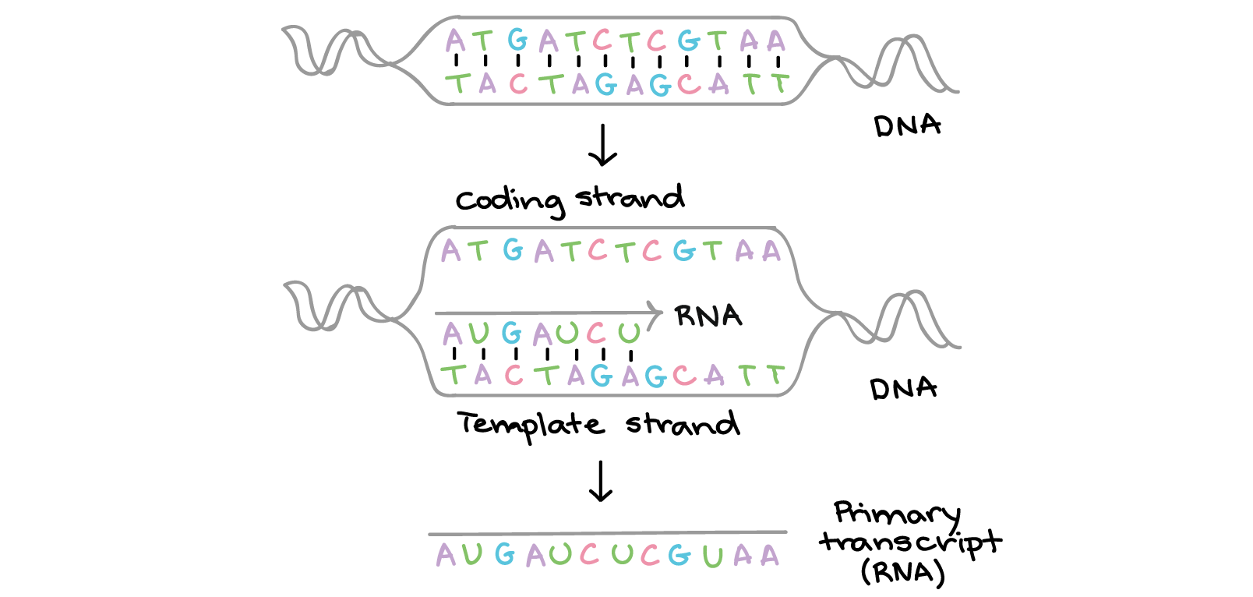
Transcription
Khan Academy, www.khanacademy.org

Slide 5
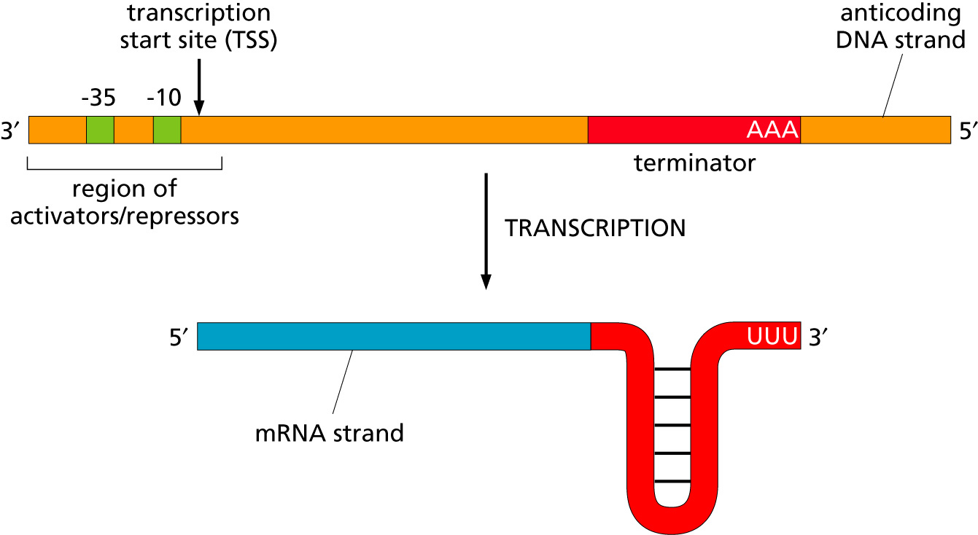
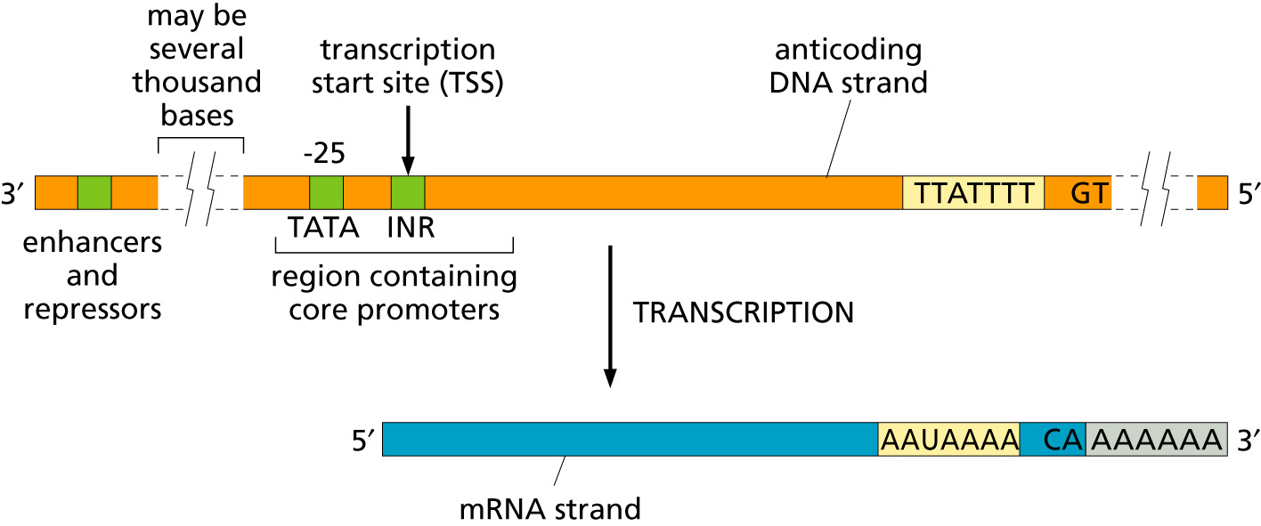
Transcription
Bacteria
Eukaryotes

Slide 6
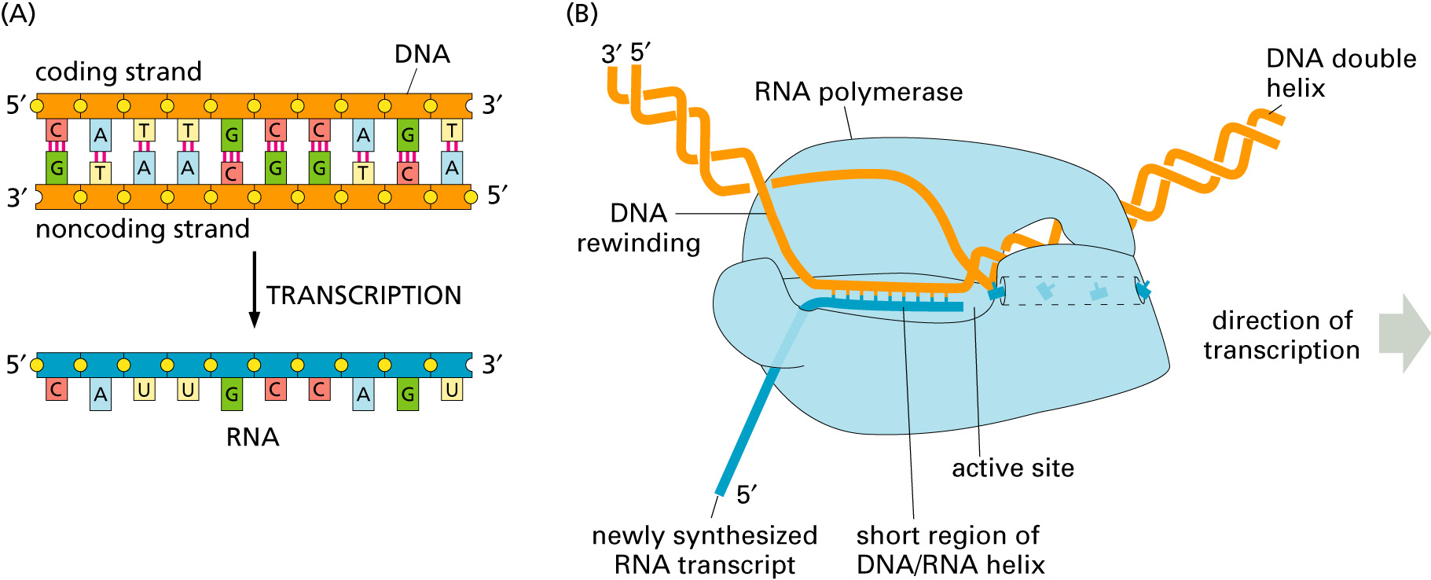
Transcription

Slide 7
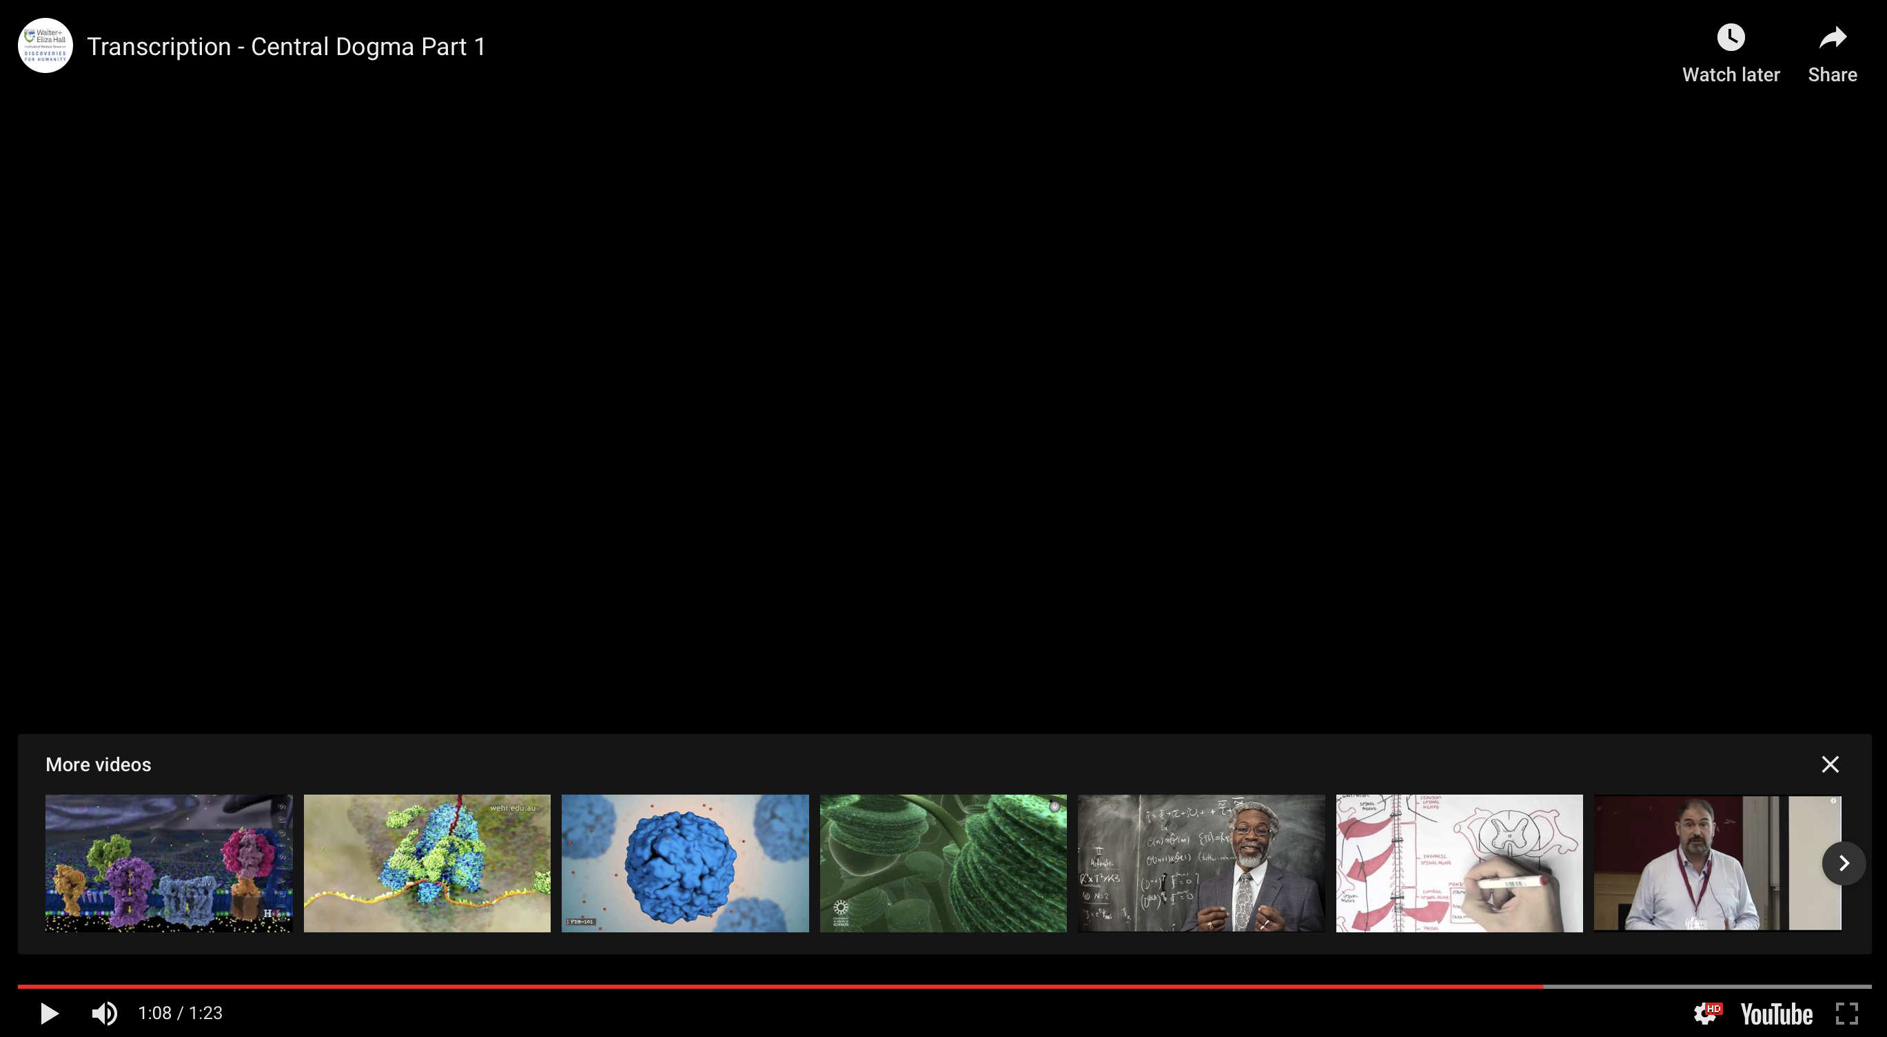
https://www.youtube.com/watch?v=xSQybiea2AA
Drew Berry

Slide 8
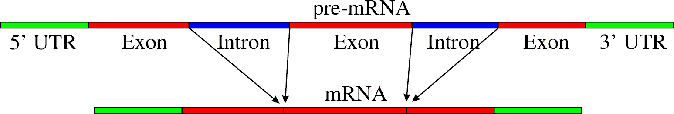
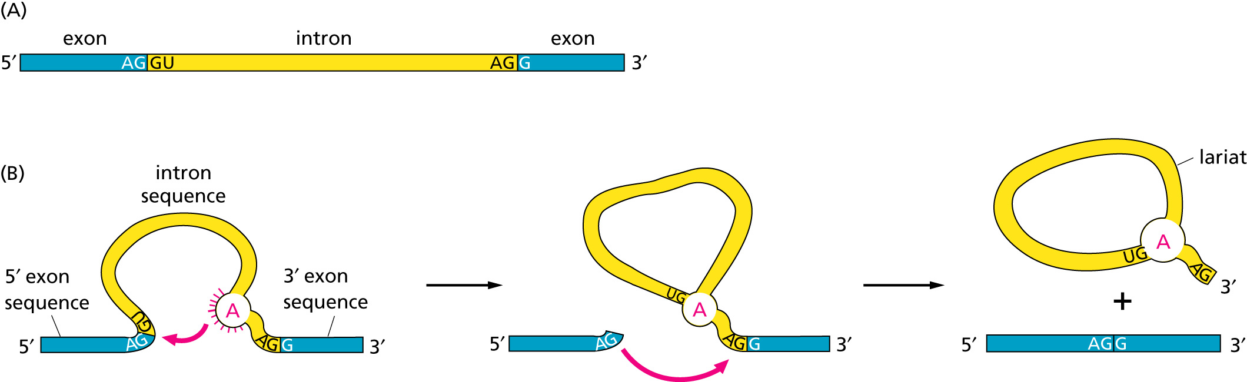
RNA processing
Simple illustration of a pre-mRNA, with introns (top). After the introns have been removed via splicing, the mature mRNA sequence is ready for translation (bottom).
Intron types
RNA can be the catalyst

Slide 9
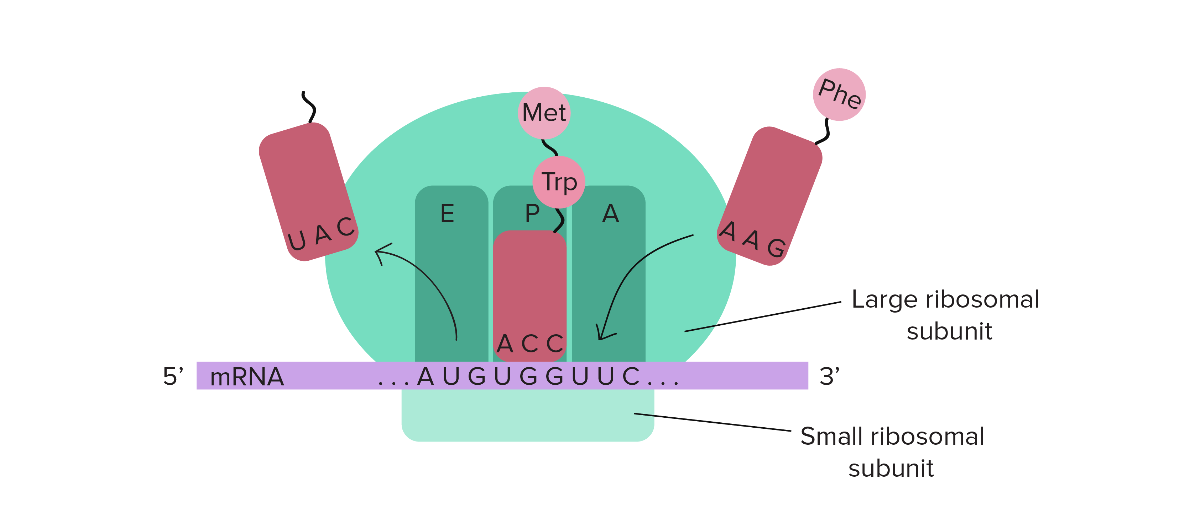
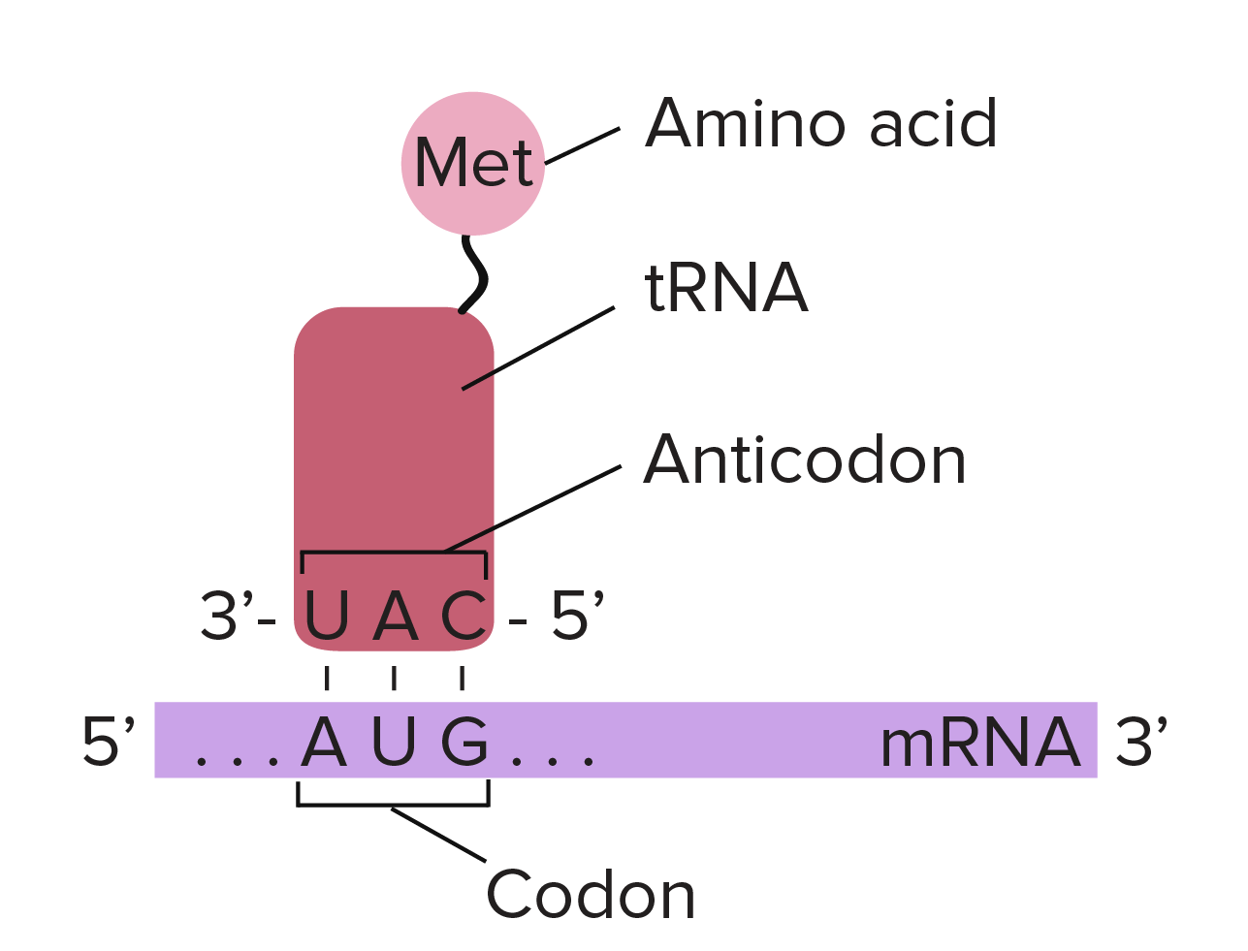
Translation

Slide 10
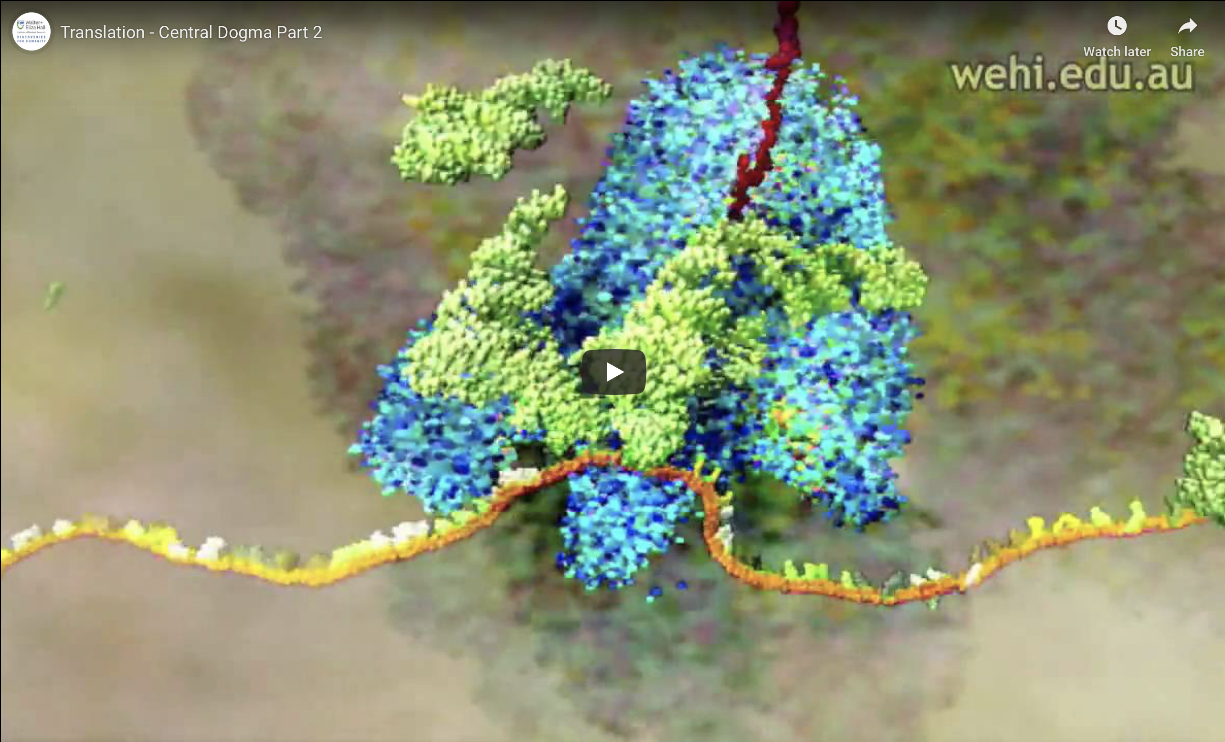
https://www.youtube.com/watch?v=WkI_Vbwn14g
Drew Berry

Slide 11
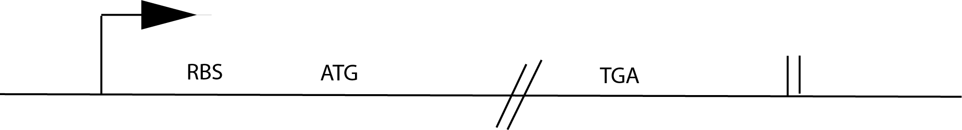
Prokarotic Gene Organization

Slide 12
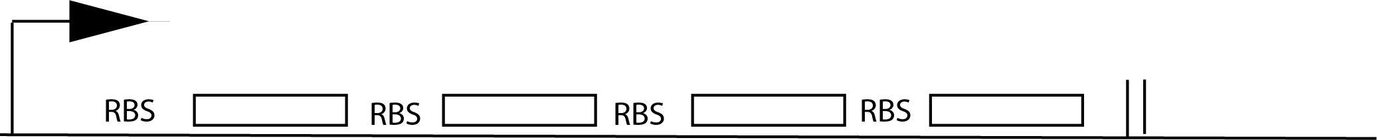
Operon Organization

Slide 13
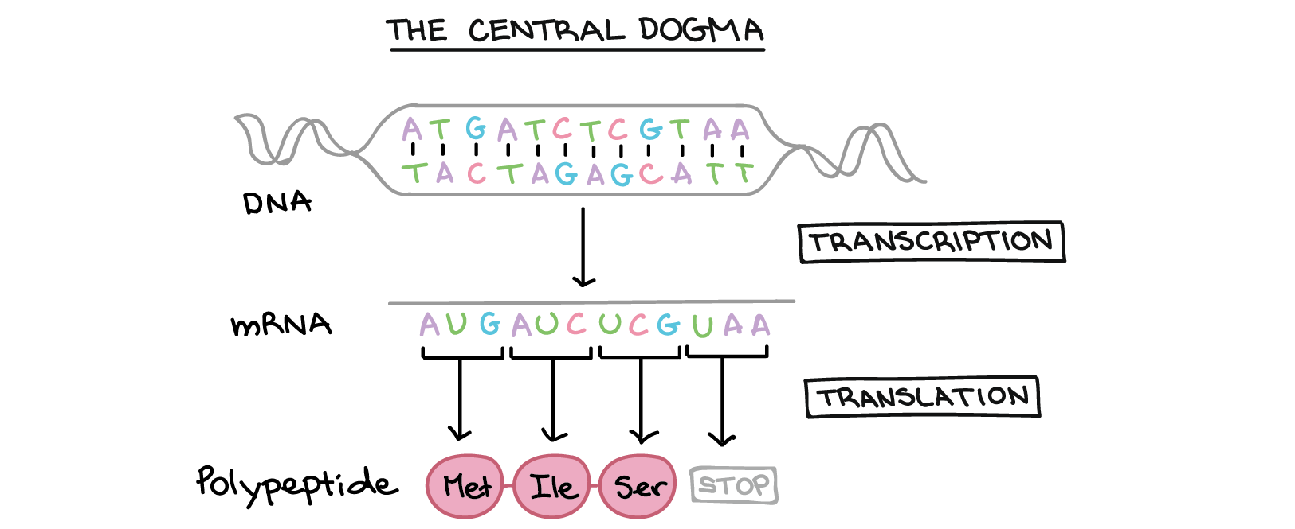
The central dogma
Why might this be wrong or incomplete
Khan Academy, www.khanacademy.org

Slide 14
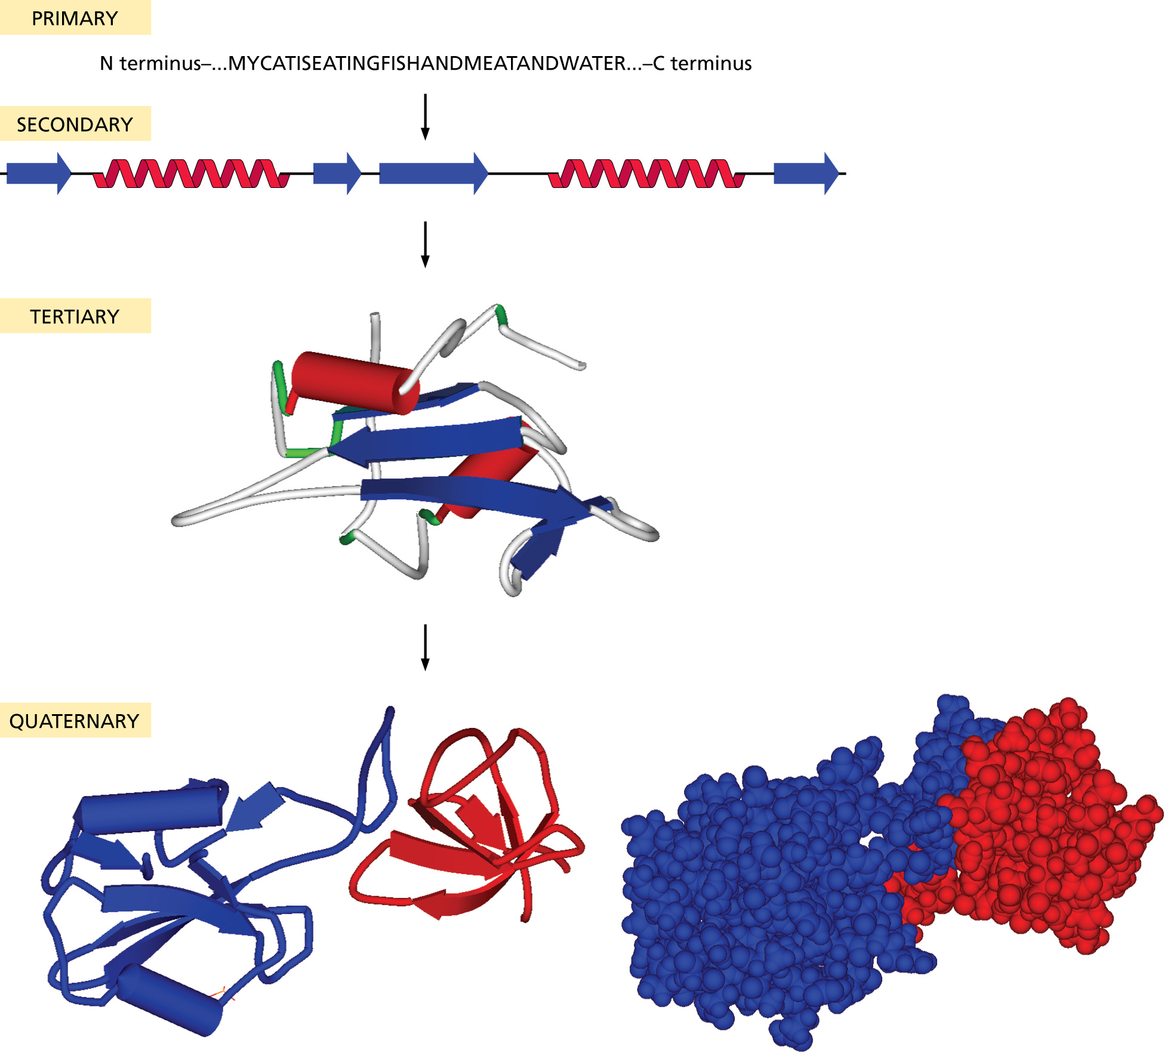
Protein structure:

Slide 15
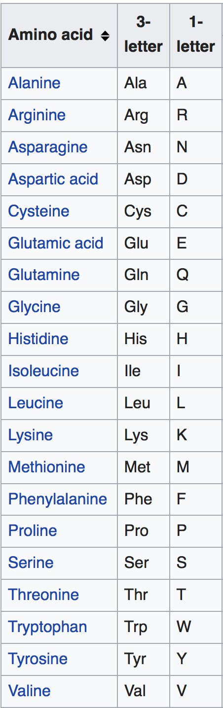
Primary structure
20 typical amino acids from the
primary sequence of a protein:
The sequence is written from the
amino to the carboxy terminal

Slide 16
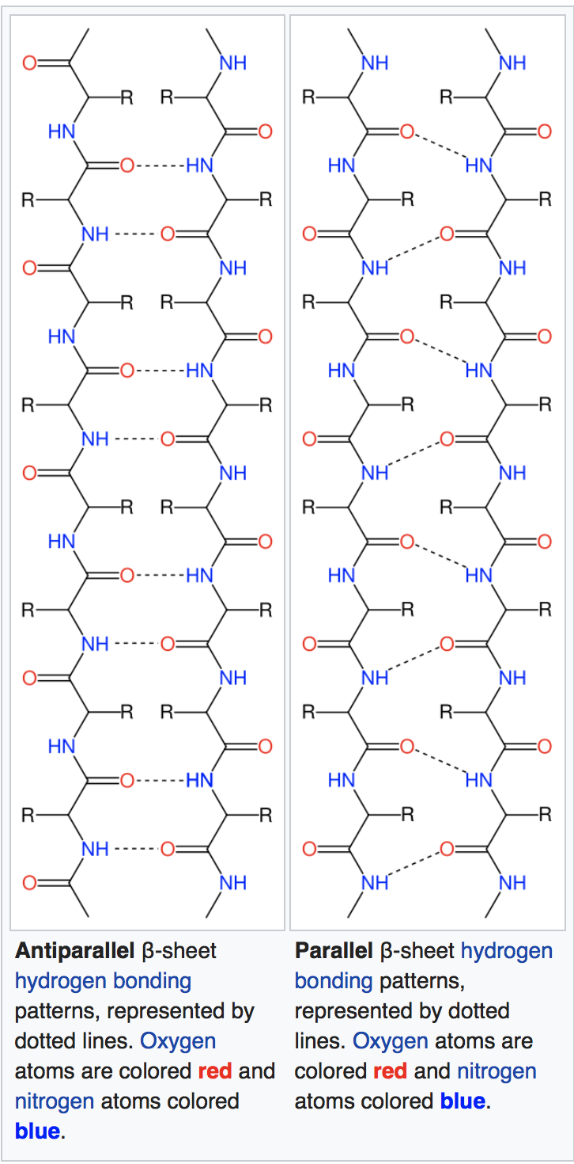
Important secondary structure elements (local folds)
Beta sheets
Often depicted
as yellow arrows
From Wikipedia
https://en.wikipedia.org/wiki/Beta_sheet
https://en.wikipedia.org/wiki/Beta_barrel

Slide 17
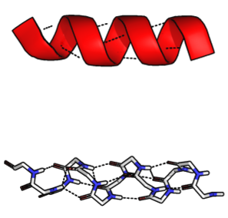
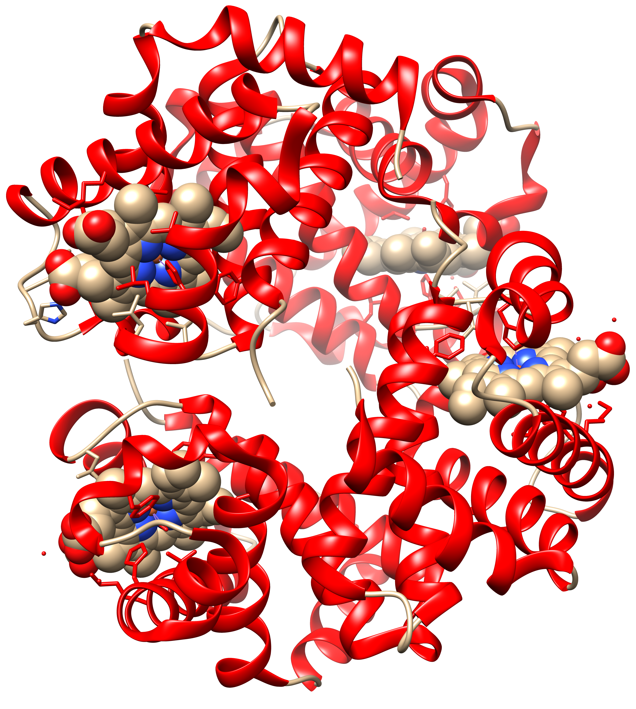
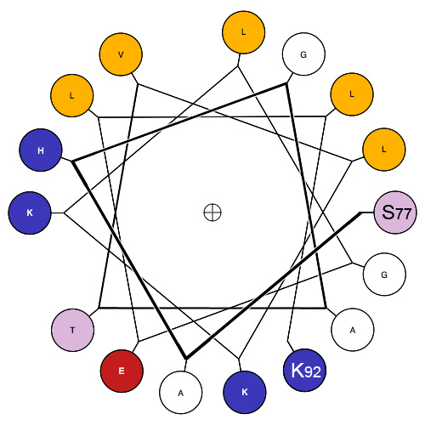
Important secondary structure elements (local folds)
Alpha Helices
Often depicted as red spirals
1GZX.pdb
Modified from Wikipedia
https://en.wikipedia.org/wiki/Alpha_helix
https://en.wikipedia.org/wiki/Hemoglobin

Slide 18
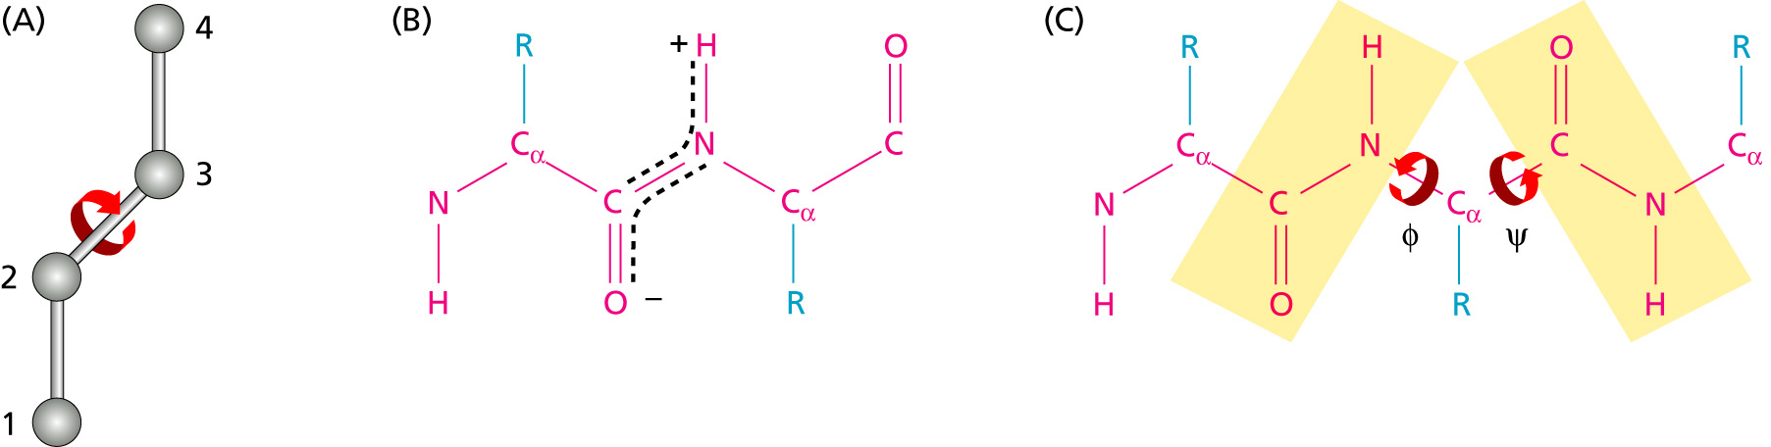
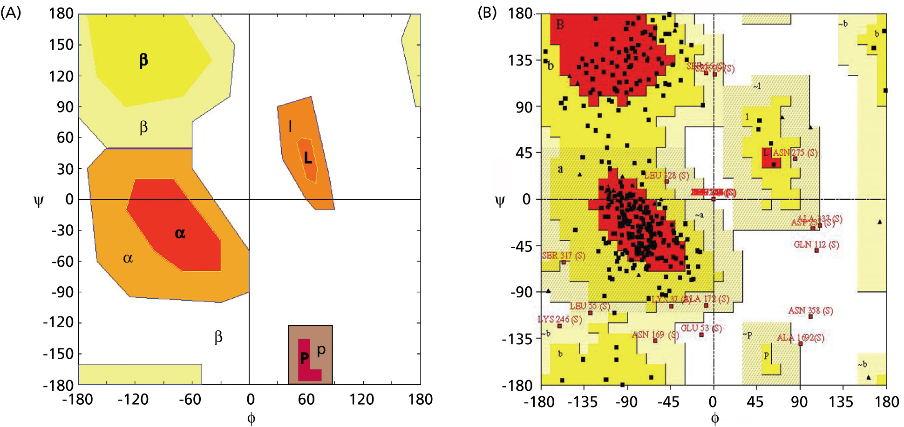
Angles in the protein backbone

Slide 19
UCSF’s Chimera
Free and powerful program to work with protein structures
Steep and long learning curve
(command line and/or menu driven)
Available for free at http://www.rbvi.ucsf.edu/chimera/
Many tutorials are available on the program’s webpage and on youtube.

Slide 20
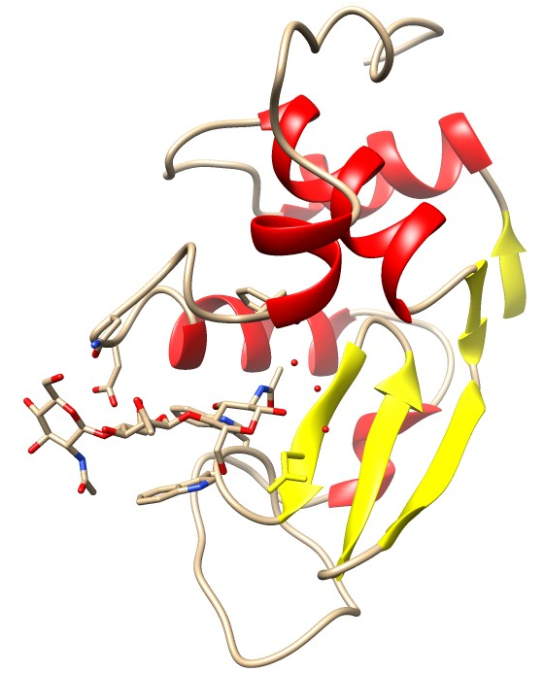
Lysozyme
Cleaves the sugar backbone on the cell wall of bacteria (which leads to exploding bacteria).
Present in tears, salvia, egg white, …
The N-acetylglucosamine (NAG) trimer is an inhibitor that binds to the catalytic site

